Slide 1
Payment Modernization
Onboarding Information
Notes:
Cover Slide

Slide 2
Table of Contents
Before Your First Day
Payment Modernization Background
New Customer Process
Solution Overview
Release Schedule
Roles and Responsibilities
USPS Payment Modernization Team
Accenture Payment Modernization Team
First Day
First Day
D Street Tech Setup
Access USPS Sites
Time
Paid Time Off
Performance
Useful Links
Acronyms

Slide 3
Before your first day

Slide 4
Payment Modernization Background
Payment Modernization will allow USPS commercial customers to securely pay for products and services with ACH Debit or Trust using one Enterprise Payment account that they can manage online
Current State
Future State
Commercial customers use a patchwork of aging payment systems without a way to manage multiple accounts
Modernize
Enable a single, secure, self-service online account management and payment system
Use secure identifier to replace bank account number and remove sensitive customer data from USPS’ servers
USPS exposes itself to a significant data breach of its customers’ bank account information
Secure
USPS supports approximately $35B in payments from commercial customers
Payment Modernization will impact 60+ stakeholders and 26+ systems
Note: CAPS, eACH Online, and EMRS will be retired as part of the Enterprise Payment project

Slide 5





New Customer Process
A new customer will go through the following process to setup an Enterprise Payment Account and utilize the manage and reporting features
Create a BCG account or
login to BCG
Enroll in Enterprise Payment System (EPS)
Manage Account from Enterprise Payment Dashboard
View Reports
Create Payment Account
Manage Products & Services
Create Enterprise Payment Account
$
Manage Notifications
Manage Payment Method
Manage Payment Account
Link EPS Account to Products/Services
Reports & Dashboards
Admin Console

Slide 6
Solution Overview
After a customer sets up an Enterprise Payment Account, they can initiate transactions within the Source System, which are processed through Enterprise Payment, Phoenix Payment, and Wells Fargo and eventually reconciled in Oracle AR
Purchase Product/Service from Source System
PostalOne!
Enterprise Payment
(eBilling)
ACH Debit
Transaction
Transaction
& Token
PC Postage
Transaction
Phoenix Payment
Wells
Fargo
NCSC
ACH Debit Status
Response & Status
NCMS
POBOL/WebBATS
POS/RSS
ACH Debit & Trust Transactions
Oracle AR

Slide 7
Project Release Schedule
 | Nov | Dec | Jan | Feb | Mar | Apr | May | Jun | Jul | Aug | Sep | Oct | Nov | Dec
Release 1
Release 2
Release 3
As-Is Flows
Status
line:
- eBilling
- POBOL
- pay.usps.com
- BCG
- Cust Reg
- Oracle AR
- RSS
To- Be Flows
Initial Story Development
Sprint 0
Development & Testing
Go-Live
As-Is Flows
- PostalOne!
- Prog Reg
- CAPS
To- Be Flows
Initial Story Development
Sprint 0
Development & Testing
Go-Live
As-Is Flows
- NCMS
- AEC/SSACS
- EMRS
- PC Postage
To- Be Flows
Initial Story Development
Sprint 0
Go-Live
Development & Testing
Note: CAPS, eACH Online, and EMRS will be retired as part of the Enterprise Payment project

Slide 8
Payment Modernization Scope
Release 1
Oracle eBilling: Core Payment Functionality
Oracle AR: Accounting processing for ePOBOL
Release 3
Oracle AR: Accounting processing for NCMS, AEC/SSACS, USPS CA, and PC Postage
Release 2
Oracle AR: Accounting processing for PostalOne! and deposits
Global Payment: Process ACH Debit transactions for PostalOne
Global Payment: Process ACH Debit transactions for ePOBOL
Business Customer Gateway: Add 2 New Services - Enterprise Payment and ePOBOL
ePOBOL: Reserve/Manage PO Boxes, Callers & Reserves online & pay using Enterprise Payment
RSS: ePOBOL refunds at retail will go back to Enterprise Payment Account
Global Payment: Process ACH Debit transactions for NCMS, AEC/ SSACS, USPS CA, and PC Postage
Business Customer Gateway: Add New Service – USPS Corporate Account
CAPS Migration: Switch existing PostalOne! CAPs customers to Enterprise Payment
USPS CA: Pay and manage USPS CA using Enterprise Payment Account
PostalOne!: Pay for Permits and non-permit mailings within PO! with Enterprise Payment Account
RSS: USPS Corporate Account transactions
RSS: EPS Trust Deposits
PC Postage: Pay for Endicia with Enterprise Payment Account
AEC/SSACS: Pay for AEC/SSACS with Enterprise Payment Account
Program Reg: Permit Online Application and Payment; retire eACH online
NCMS: Pay for ACH Debit bulk stamps with Enterprise Payment Account
Oracle eBilling: Core Payment Functionality
Customer Registration: Customers will utilize existing online account structure and access code for EPS

Slide 9
Roles and Responsibilities
Payment Modernization will be a coordinated effort between Enterprise Payment and each of the Source Systems to create a seamless customer experience
As-Is Flows
To Be Flows
Intial Story Development
Finalize Timeline
Develop/Deploy
Create As-Is flow and/or create As-Is overview
Document Change Analysis
Incorporate feedback
Use SRS to develop To-Be solution flows for Enterprise Payment (EPS)
Create epics, features, and user stories for enterprise payment solution
Gather source system timelines
Finalize EPS schedule
Development Sprints
Backlog grooming
SIT/CAT Test
Deploy
EPS Team
Provide existing documentation
Review Accenture As-Is documentation & provide feeback
Use SRS & EPS solution flows to create flows for source system
Create epics, features, and user stories for source system to connect to EPS
Cofirm timeline from EPS for source system development
Development Sprints
Backlog grooming
SIT/CAT Test
Deploy
Source System

Slide 10
USPS Payment Modernization Team

Slide 11
Accenture Payment Modernization Team

Slide 12
first day

Slide 13
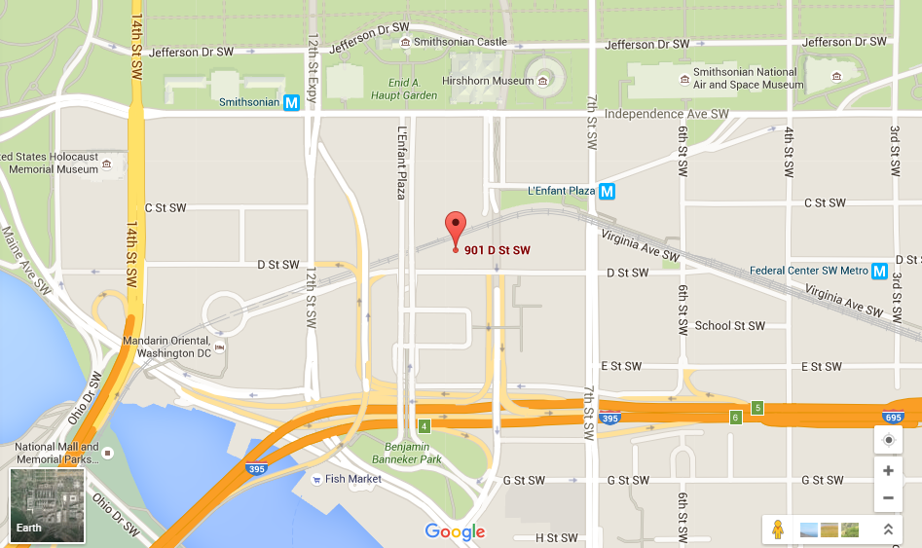
First Day
Accenture USPS Account Office:
Address: 901 D Street SW, Washington DC 20024 (Suite 101)
Metro: L’Enfant Plaza Metro is right across the street from the office

Slide 14

D Street Tech Setup
Obtain APN: Your APN allows you to access Accenture D street websites and printers
Once you receive your roll on email with your APN credential (last name_first name), stop by the D Street tech support office (113) and reset your password
Printers: Connect to the D Street Printers (required after restarting your computer)
Go to ‘Run’ within the ‘Start’ menu and type in \\170.248.232.90 in the Search Bar and hit Enter.
When prompted, enter your APN credentials: APN\last name_first name with APN password.
Select the option to Remember my credentials.
Double-click on any/all printers you need and install necessary drivers when prompted.
1st Floor Production Room Printers | 1st Floor Printers Near PayMod
Ky137copier1 | Hp144
Ky137copier2 | Hp142

Slide 15
Access USPS Sites
Proxy Setting: Changing your Proxy Setting allows you to visit USPS sites from D Street
Open Internet Explorer -> Tools -> Internet Options -> Connections -> LAN Settings
Remove the current Accenture proxy path and paste this is in the box:
http://proxyserver/adcproxy.pac
Obtain ACE ID: Your ACE ID allows you to log into USPS websites
After you obtain your security clearance, follow these steps:
Advise your Accenture Manager that you have received your Clearance.
Your Accenture Manager with a current Security Clearance must request an ACE ID for you so that you can access data on the USPS Network.
Please work with your Accenture Manager to contact Jeanettte Cook and ensure you are in E-ACCESS with a EID and UID
If you already have a USPS UID and can't login, call the USPS Help desk at 800-877-7435 to reset your password

Slide 16
Time
System | Description | Login | When to Enter | Instructions
T&E Time & Expense | Daily time reporting system for AFS resources | Enterprise ID | Daily | T&E Help
PayMod Charge Codes | Description
17715.0002.001.001 | Allowable - Time you bill to the client each day
17715.0002.001.002 | Non-Billable - Team lunch or commute expense
17715.0002.001.003 | Unallowable Alcohol expense Morale

Slide 17
Paid Time Off
Paid Time Off Balance:
In T&E, open your current timesheet
Select the “Leave” button on the top of the page
In the Leave window, you can view your Paid Time Off, Floating Holiday, and Holiday time available
Request Paid Time Off:
Send an email to your supervisor with the days you want to take PTO
After approval, enter your PTO into the PayMod Team Calendar

Slide 18
Performance
Objectives & Performance Feedback (**AFS Resources**)
Enter objectives in myPerformance in the next 2 weeks
Assign to your lead
Feedback Forms will be reviewed by Steffen/Dwain and Pete prior to submission
Regular Feedback
Team leads will be setting up feedback discussions with you
Set up 30/30 meetings with your team lead
Ask for Feedback!

Slide 19
Useful Links
D Street Links
Login: APN/last name_first name
Pay Mod SharePoint Site: Save PayMod documents here
USPS Account Portal: Access D st. and Pace information
Meeting Room Manager: Reserve meeting space at D Street here
PayMod Distro: Email Sunaina Arshad to be added to the distro
USPS Links
Login: USA\ACE ID
USPS Portal: Access all internal USPS links from their Portal
eAccess: Request access to PCTS, USPS webmail, and other USPS systems
USPS Directory: Lookup USPS phone, email, and office contacts
USPS Webmail: Access your USPS email

Slide 20
Acronyms
Acronym | Description
ACH | Automated Clearing House
AEC | Address Element Correction
BCG | Business Customer Gateway
CAPS | Centralized Account Processing System
CNSB Pro | Click N Ship for Business Pro
CRID | Customer Registration ID
EMRS | Electronic Marketing Reporting System
EPA | Enterprise Payment Account
EPS | Enterprise Payment System
e-VS | Electronic Verification System
ICAPS | International Centralized Account Processing System
MEPT | Mail Entry and Payment Technology
MID | Mailer ID
NAN | National Account Number
NCMS | National Customer Management System
POBOL | PO Box Online
POS | Point of Service
PRU | Postal Retail Unit
RSS | Retail Service System
SAFR | Standard Accounting for Retail
SBP | Scan Based Payment
SEC | Standard Entry Class Code
SSACS | Single Source Address Change Services
WebBATS | Web Box Activity Tracking System
Note: See the PayMod Glossary for descriptions and more information

